Slide 1
Recursion

Slide 2
recursion
A function calls itself repeatedly until a certain condition is met (this condition being the base case).

Slide 3
iteration
Iteration: A function repeats a defined process until a condition fails. This is usually done through a loop, such as a for or while loop with a counter and comparative statement making up the condition that will fail. An infinite loop for iteration occurs when the condition never fails.

Slide 4
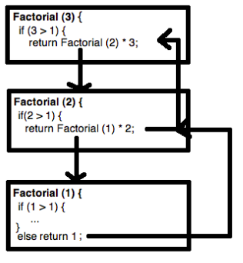
Algorithm
def factorial(n) if n > 1 return factorial(n - 1) * n else return 1 end end

Slide 5
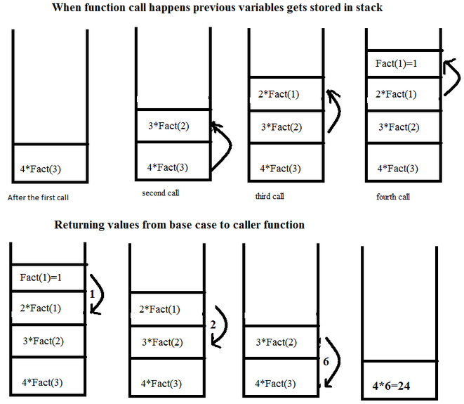
Recursion

Slide 6
Recursion: Stack point of view
recursion is memory intensive because it requires an allocated stack frame, which can be shown by the above columns/buckets.
For every call of the function, another element is added to the stack and once the base case is reached (at the top of the stack, or the last entry), the element is “popped” off of the top and that value is passed to the value below it.

Slide 7
Pros and Cons of Recursion
A recursive program has greater space requirements than an iterative program as each function call will remain in the stack until the base case is reached.
It also has greater time requirements because each time the function is called, the stack grows and the final answer is returned when the stack is popped completely.
For a recursive function, you only need to define the base case and recursive case, so the code is simpler and shorter than an iterative code.
Some problems are inherently recursive, such as Graph and Tree Traversal.

Slide 9
Factorial (N!)
N! = (N-1)! * N [for N > 1]
1! = 1
3!
= 2! * 3
= (1! * 2) * 3
= 1 * 2 * 3
Recursive design:
Decomposition: (N-1)!
Composition: * N
Base case: 1!

Slide 10
factorial Method
public static int factorial(int n)
{
int fact;
if (n > 1) // recursive case (decomposition)
fact = factorial(n – 1) * n; // composition
else // base case
fact = 1;
return fact;
}

Slide 11
public static int factorial(int 3)
{
int fact;
if (n > 1)
fact = factorial(2) * 3;
else
fact = 1;
return fact;
}

Slide 12
public static int factorial(int 3)
{
int fact;
if (n > 1)
fact = factorial(2) * 3;
else
fact = 1;
return fact;
}
public static int factorial(int 2)
{
int fact;
if (n > 1)
fact = factorial(1) * 2;
else
fact = 1;
return fact;
}

Slide 13
public static int factorial(int 3)
{
int fact;
if (n > 1)
fact = factorial(2) * 3;
else
fact = 1;
return fact;
}
public static int factorial(int 2)
{
int fact;
if (n > 1)
fact = factorial(1) * 2;
else
fact = 1;
return fact;
}
public static int factorial(int 1)
{
int fact;
if (n > 1)
fact = factorial(n - 1) * n;
else
fact = 1;
return fact;
}

Slide 14
public static int factorial(int 3)
{
int fact;
if (n > 1)
fact = factorial(2) * 3;
else
fact = 1;
return fact;
}
public static int factorial(int 2)
{
int fact;
if (n > 1)
fact = factorial(1) * 2;
else
fact = 1;
return fact;
}
public static int factorial(int 1)
{
int fact;
if (n > 1)
fact = factorial(n - 1) * n;
else
fact = 1;
return 1;
}

Slide 15
public static int factorial(int 3)
{
int fact;
if (n > 1)
fact = factorial(2) * 3;
else
fact = 1;
return fact;
}
public static int factorial(int 2)
{
int fact;
if (n > 1)
fact = 1 * 2;
else
fact = 1;
return fact;
}
public static int factorial(int 1)
{
int fact;
if (n > 1)
fact = factorial(n - 1) * n;
else
fact = 1;
return 1;
}

Slide 16
public static int factorial(int 3)
{
int fact;
if (n > 1)
fact = factorial(2) * 3;
else
fact = 1;
return fact;
}
public static int factorial(int 2)
{
int fact;
if (n > 1)
fact = 1 * 2;
else
fact = 1;
return 2;
}

Slide 17
public static int factorial(int 3)
{
int fact;
if (n > 1)
fact = 2 * 3;
else
fact = 1;
return fact;
}
public static int factorial(int 2)
{
int fact;
if (n > 1)
fact = 1 * 2;
else
fact = 1;
return 2;
}

Slide 18
public static int factorial(int 3)
{
int fact;
if (n > 1)
fact = 2 * 3;
else
fact = 1;
return 6;
}

Slide 19
Execution Trace (decomposition)
public static int factorial(int n)
{
int fact;
if (n > 1) // recursive case (decomposition)
fact = factorial(n – 1) * n; (composition)
else // base case
fact = 1;
return fact;
}
factorial(4)
factorial(3) 4

Slide 20
Execution Trace (decomposition)
public static int factorial(int n)
{
int fact;
if (n > 1) // recursive case (decomposition)
fact = factorial(n – 1) * n; (composition)
else // base case
fact = 1;
return fact;
}
factorial(4)
factorial(3) 4
factorial(2) 3

Slide 21
Execution Trace (decomposition)
public static int factorial(int n)
{
int fact;
if (n > 1) // recursive case (decomposition)
fact = factorial(n – 1) * n; (composition)
else // base case
fact = 1;
return fact;
}
factorial(4)
factorial(3) 4
factorial(2) 3
factorial(1) 2

Slide 22
Execution Trace (composition)
public static int factorial(int n)
{
int fact;
if (n > 1) // recursive case (decomposition)
fact = factorial(n – 1) * n; (composition)
else // base case
fact = 1;
return fact;
}
factorial(4)
*
factorial(3) 4
*
factorial(2) 3
*
factorial(1)->1 2

Slide 23
Execution Trace (composition)
public static int factorial(int n)
{
int fact;
if (n > 1) // recursive case (decomposition)
fact = factorial(n – 1) * n; (composition)
else // base case
fact = 1;
return fact;
}
factorial(4)
*
factorial(3) 4
*
factorial(2)->2 3

Slide 24
Execution Trace (composition)
public static int factorial(int n)
{
int fact;
if (n > 1) // recursive case (decomposition)
fact = factorial(n – 1) * n; (composition)
else // base case
fact = 1;
return fact;
}
factorial(4)
*
factorial(3)->6 4

Slide 25
Execution Trace (composition)
public static int factorial(int n)
{
int fact;
if (n > 1) // recursive case (decomposition)
fact = factorial(n – 1) * n; (composition)
else // base case
fact = 1;
return fact;
}
factorial(4)->24

Slide 26
Improved factorial Method
public static int factorial(int n)
{
int fact=1; // base case value
if (n > 1) // recursive case (decomposition)
fact = factorial(n – 1) * n; // composition
// else do nothing; base case
return fact;
}

Slide 27
Fibonacci Series

Slide 28
Fibonacci Numbers
The Nth Fibonacci number is the sum of the previous two Fibonacci numbers
0, 1, 1, 2, 3, 5, 8, 13, …
Recursive Design:
Decomposition & Composition
fibonacci(n) = fibonacci(n-1) + fibonacci(n-2)
Base case:
fibonacci(1) = 0
fibonacci(2) = 1

Slide 29
fibonacci Method
public static int fibonacci(int n)
{
int fib;
if (n > 2)
fib = fibonacci(n-1) + fibonacci(n-2);
else if (n == 2)
fib = 1;
else
fib = 0;
return fib;
}

Slide 30
Execution Trace (decomposition)
fibonacci(4)
fibonacci(3)
fibonacci(2)

Slide 31
Execution Trace (decomposition)
fibonacci(4)
fibonacci(3)
fibonacci(2)
fibonacci(2)
fibonacci(1)

Slide 32
Execution Trace (composition)
fibonacci(4)
+
fibonacci(3)
fibonacci(2)
+
fibonacci(2)->1
fibonacci(1)->0

Slide 33
Execution Trace (composition)
fibonacci(4)
+
fibonacci(3)->1
fibonacci(2)->1

Slide 34
Execution Trace (composition)
fibonacci(4)->2

Slide 35
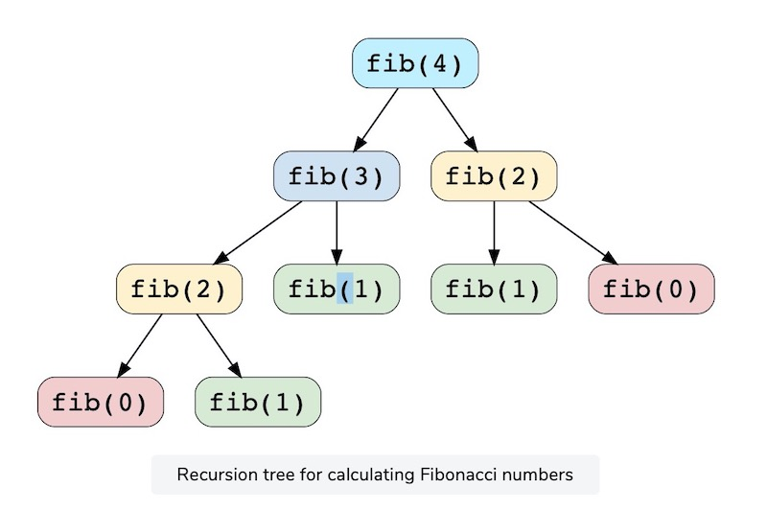

Slide 36
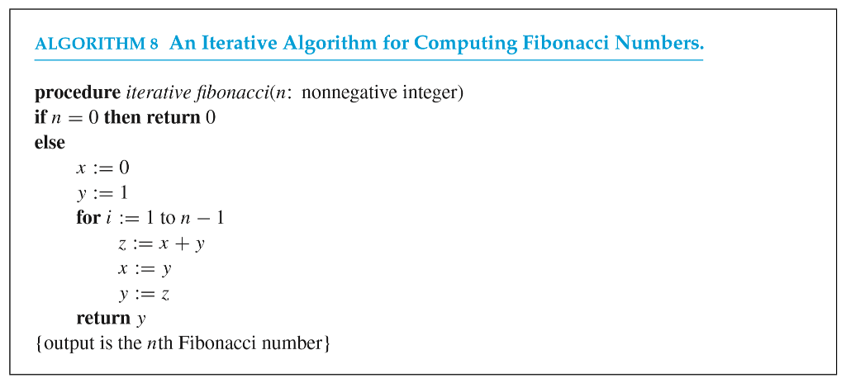

Slide 37
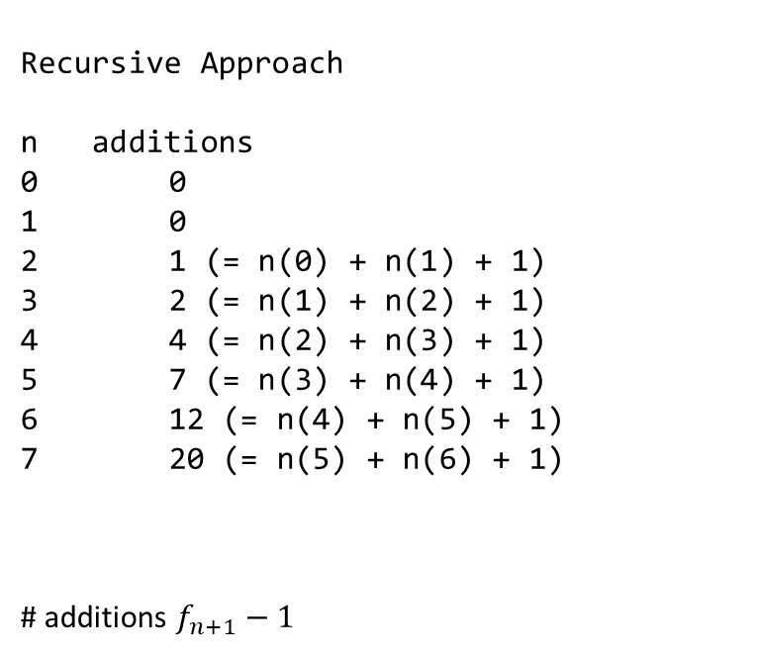
Comparison (# Additions)
Recursive Approach
n additions
0 0
1 0
2 1 (= n(0) + n(1) + 1)
3 2 (= n(1) + n(2) + 1)
4 4 (= n(2) + n(3) + 1)
5 7 (= n(3) + n(4) + 1)
6 12 (= n(4) + n(5) + 1)
7 20 (= n(5) + n(6) + 1)
# additions $f_{n+1}−1$
Iterative Approach
# additions N-1

